Slide 2
Objectives
Understand the concept of iteration
Count-controlled loops (FOR loops)
Pre-condition loops (WHILE loops)
Post-condition loops (REPEAT…UNTIL… loops)
Write algorithms in pseudo-code involving sequence, selection and iteration

Slide 3
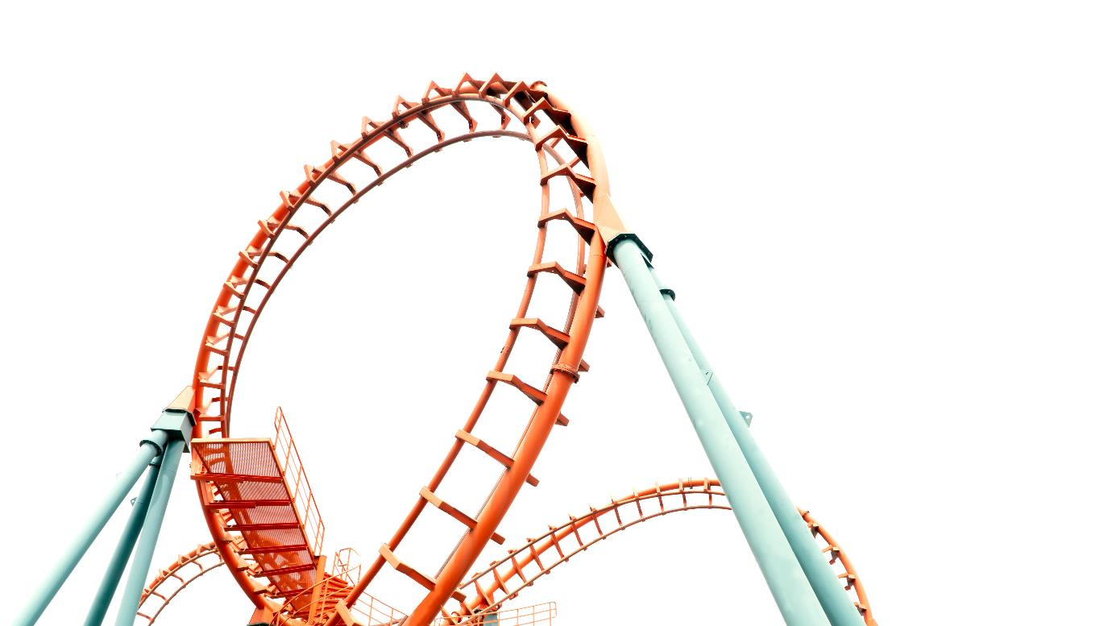

Starter
What does iteration mean?
What are three types of loop that can be used in programming languages for iteration?

Slide 4
Iteration
Iteration means repetition of a section of code
There are three types of iteration statement in most languages such as Visual Basic, Python, and Java
FOR … NEXT …
WHILE … ENDWHILE
REPEAT … UNTIL …
Some languages, such as Python, do not have the REPEAT … UNTIL … statement

Slide 5
FOR loops
Use this when you want to execute the loop a specified number of times
Total ← 0
FOR i ← 1 TO 7
INPUT DailyTemperature
Total ← Total + DailyTemperature
NEXT i
averageWeeksTemp ← total / 7
OUTPUT averageWeeksTemp
i starts at 1 and goes to 7
Perform iteration
x 7
Add 1 to i

Slide 6
FOR loops
FOR loops are also known as count-controlled loops
This is because they have a counter known as an iterator that controls the number of times they are executed
It is common for the letter i to be used for the iterator’s name
Alternatively, another meaningful name can be used
FOR i ← 1 TO 10
OUTPUT i
NEXT i
FOR Rows ← 1 TO 10
OUTPUT Rows
NEXT i
Example using i as an iterator
Example using a meaningful name as an iterator

Slide 7
Using STEP with FOR loops
FOR loops usually add one (increment) the iterator
It is possible to use a different number each loop
This number may also be negative – in which case the iterator counts down
Predict the output of each of the programs shown
Program 1
Program 2
FOR Even ← 2 TO 10 STEP 2
OUTPUT Even
NEXT Even
FOR Count ← 10 TO 0 STEP -1
OUTPUT Count
NEXT Count

Slide 8
Using STEP with FOR loops
Predict the output of each of the programs shown
Program 1: 2 4 6 8 10
Program 2: 10 9 8 7 6 5 4 3 2 1 0
Program 1
Program 2
FOR Even ← 2 TO 10 STEP 2
OUTPUT Even
NEXT Even
FOR Count ← 10 TO 0 STEP -1
OUTPUT Count
NEXT Count

Slide 9
WHILE loops
Use this when you want to execute the loop WHILE a certain condition is true.
OUTPUT "Please enter password: " INPUT Password
WHILE Password <> "jd8UpP2+d" OUTPUT "Invalid password – try again" INPUT Password
ENDWHILE
OUTPUT "Correct password"
The condition is tested at the beginning of the loop
It is also known as a pre-condition loop
How many times will the loop be executed if the user always enters "jd8Upp2d"?
Check condition
Perform iteration if the condition is True

Slide 10
WHILE loops
OUTPUT "Please enter password: " INPUT Password
WHILE Password <> "jd8UpP2+d" OUTPUT "Invalid password – try again" INPUT Password
ENDWHILE
OUTPUT "Correct password"
How many times will the loop be executed if the user always enters "jd8Upp2d"?
The loop will continue forever as the password entered is incorrect
If a loop continues forever and there is no way to exit it, it is called an infinite loop

Slide 11
WHILE … ENDWHILE flowchart
OUTPUT "Please enter password: " INPUT Password
WHILE Password <> "jd8UpP2+d" OUTPUT "Invalid password – try again" INPUT Password
ENDWHILE
OUTPUT "Correct password"
INPUT password
Password != "jd8UpP2+d"
Yes
No
OUTPUT "Invalid password"
INPUT password

Slide 12
Worksheet 3
Now complete Task 1, Task 2 and Task 3 on Worksheet 3

Slide 13
REPEAT … UNTIL … loops
Use this when you want to execute the loop until a certain condition is True
These loops are also known as post-condition loops
The condition is tested at the end of the loop
Rewrite this algorithm using a REPEAT…UNTIL … loop instead of a WHILE loop
INPUT Password
WHILE Password <> "jd8UpP2+d"
OUTPUT "Invalid password – try again"
INPUT Password
ENDWHILE
OUTPUT "Correct password"

Slide 14
REPEAT … UNTIL loops
Use this when you want to execute the loop until a certain condition is True
The loop will always execute once
The condition is tested at the end of the loop
Password ← ""
REPEAT
OUTPUT "Invalid password – try again"
INPUT Password
UNTIL Password = "jd8UpP2+d"
OUTPUT "Correct password"
Perform iteration
Check condition
Condition
True

Slide 15
Worksheet 3
Now complete Task 4 on Worksheet 3

Slide 16
Plenary
What are three types of programming loops?
For each of the following situations, explain how you could use a loop to solve it:
Ask a user to enter their name – if they don’t enter a name longer than one letter, then keep on asking them to enter their name
Count from 1 to 100
Repeatedly check the state of a game to see if one of the players has won

Slide 17
Plenary
What are three types of programming loops?
FOR loop, WHILE loop, REPEAT UNTIL loop
Ask a user to enter their name – if they don’t enter a name longer than one letter, then keep on asking them to enter their name
REPEAT UNTIL loop
Count from 1 to 100 – FOR loop
Repeatedly check the state of a game to see if one of the players has won
WHILE loop

